Slide 1
Programming II
(C Programming Language)
Pointers in C
(Part I)
Lecture 13, Monday March 29, 2021
Dr. Ayman ALJARBOUH

Slide 2
Outline
C Pointers
NULL Pointers in C
Pointer Arithmetic in C

Slide 3
C Pointers
Pointers are powerful features of C and C++ programming
Some C programming tasks are performed more easily with pointers
Other tasks, such as dynamic memory allocation, cannot be performed without using pointers
Pointers are special variables that are used to store addresses rather than values
So, before we learn pointers, we start with a reminder about addresses in C programming

Slide 4

Addresses in C Programming
Every variable is a memory location and every memory location has its address defined which can be accessed using ampersand (&) operator
If you have a variable var in your program, then &var will give you its address in the memory
We have used address numerous times while using the scanf() function
Here, the value entered by the user is stored in the address of var variable

Slide 5
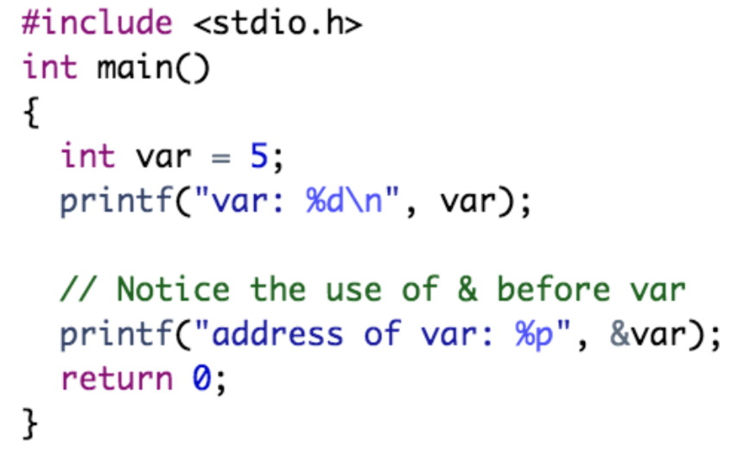
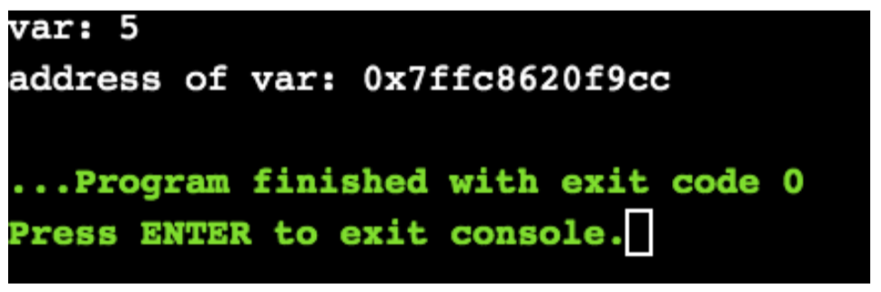
Addresses in C Programming
Example:
Note: You will probably get a different address when you run the above code

Slide 6

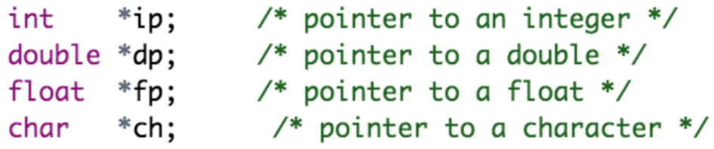
What Are Pointers in C?
Pointers (pointer variables) are special variables that are used to store addresses rather than values
Like any variable or constant, you must declare a pointer before you can use it to store any variable address. The syntax is:
Following are valid pointer declarations:

Slide 7
How to Use Pointers?
There are few important operations, which we will do with the help of pointers very frequently:
Pointer variable declaration
Assigning the address of a variable to a pointer: This is done by using the ampersand (&) operator
Access the value at the address available in the pointer variable: This is done by using unary operator * that returns the value of the variable located at the address specified by its operand

Slide 8
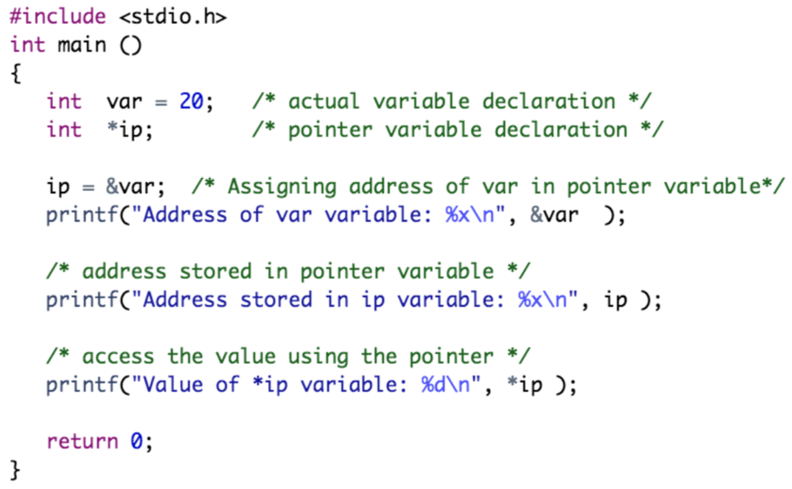
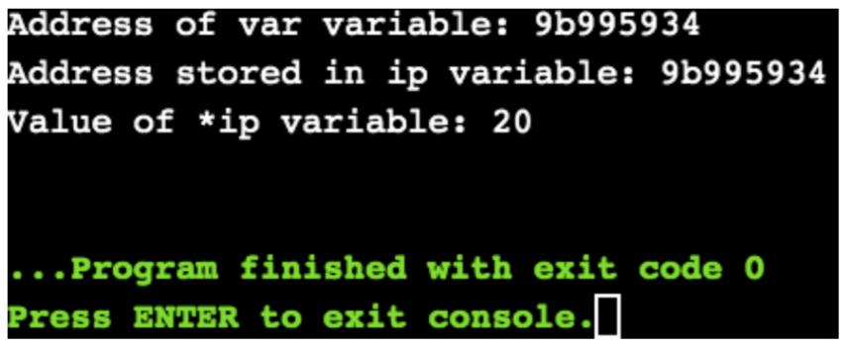
Example:
Note: In the above example, ip is the pointer and not *ip. The * operator is used to give the value stored in the pointer ip, which is the value of the variable var

Slide 9
Example:
In the above example:
We have declared a pointer ip and a normal variable var

Slide 10
Example:
In the above example:
The integer value 20 is assigned to the variable var. And, the address of var is assigned to the pointer ip

Slide 11
Example:
In the above example:
We used the operator * (i.e. *ip) to access the value of the variable var that is pointed by the pointer ip

Slide 12
Example:
In the above example:
It is possible to replace the two statements “int *ip;” and “ip=&var;” by a single statement “int *ip = &var”

Slide 13
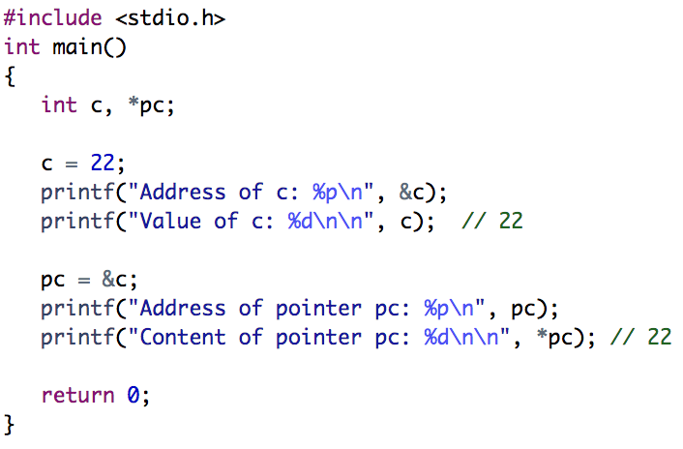
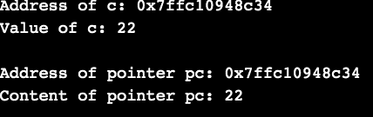
Example:

Slide 14
Outline
C Pointers
NULL Pointers in C
Pointer Arithmetic in C

Slide 15
NULL Pointers in C
A pointer that is assigned NULL is called a null pointer, and a null pointer is a pointer which points nothing
Some uses of the null pointer are
To initialize a pointer variable when that pointer variable isn’t assigned any valid memory address yet
To pass a null pointer to a function argument when we don’t want to pass any valid memory address
To check for null pointer before accessing any pointer variable. So that, we can perform error handling in pointer related code

Slide 16
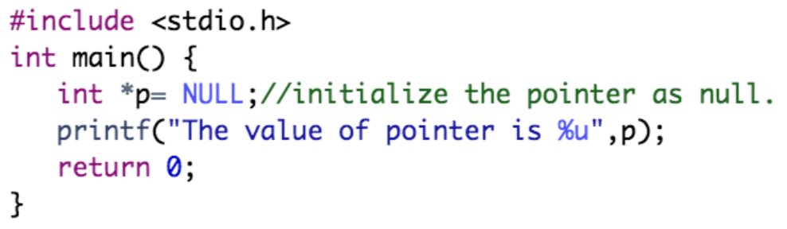
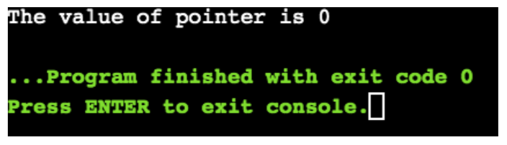
NULL Pointers in C
Example:

Slide 17
Outline
C Pointers
NULL Pointers in C
Pointer Arithmetic in C

Slide 18
Pointer Arithmetic in C
We can perform arithmetic operations on the pointers like addition, subtraction, etc
However, as we know that pointer contains the address:
The result of an arithmetic operation performed on the pointer will also be a pointer if the other operand is of type integer
In pointer-from-pointer subtraction, the result will be an integer value

Slide 19
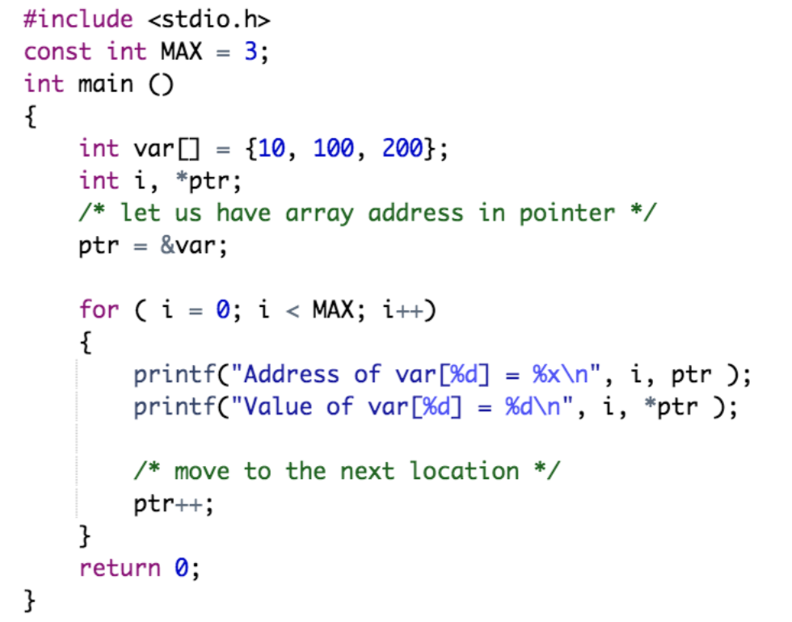
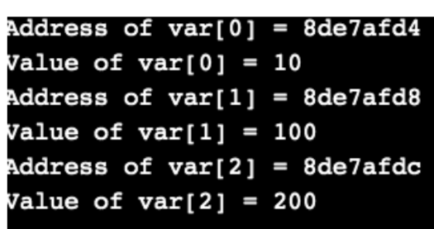
Incrementing a Pointer in C
If we increment a pointer by 1, the pointer will start pointing to the immediate next location

Slide 20
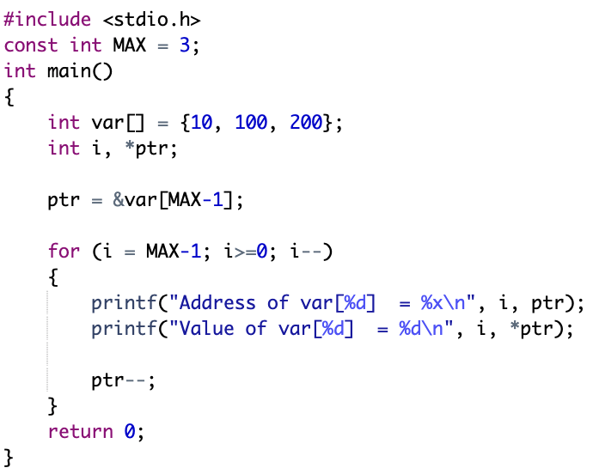
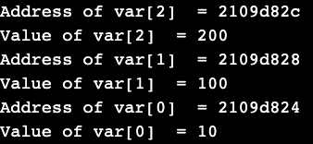
Decrementing a Pointer in C
The same considerations apply to decrementing a pointer, which decreases its value by the number of bytes of its data type

Slide 21
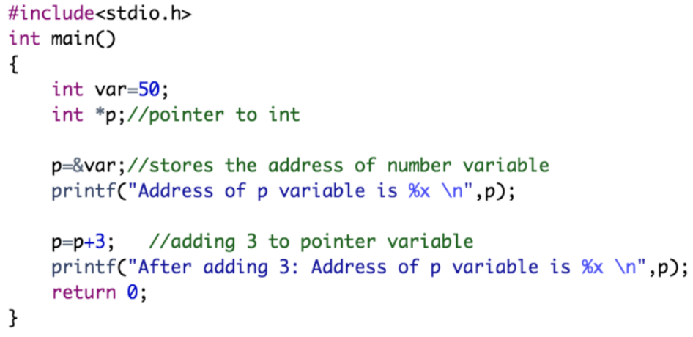
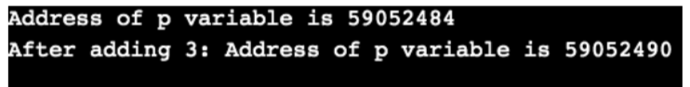
C Pointer Addition
We can add a value to the pointer variable
For 32-bit int variable, it will add 2 multiplied by the added number, as integer value occupies 2-byte memory in 32-bit OS
For 64-bit int variable, it will add 4 multiplied by the added number, as integer value occupies 4-byte memory in 64-bit OS
Here, the address of p is 59052484. But after adding 3 with p variable, it is 59052490, i.e., 2*3=6 increment. This is when using 32-bit architecture; it increments 6, as integer value occupies 2-byte memory in 32-bit OS.

Slide 22
C Pointer Addition
We can add a value to the pointer variable
For 32-bit int variable, it will add 2 multiplied by the added number, as integer value occupies 2-byte memory in 32-bit OS
For 64-bit int variable, it will add 4 multiplied by the added number, as integer value occupies 4-byte memory in 64-bit OS
But if we were using 64- bit architecture, it would be incrementing by 12, i.e., 4*3=12, as integer value occupies 4-byte memory in 64-bit OS

Slide 23
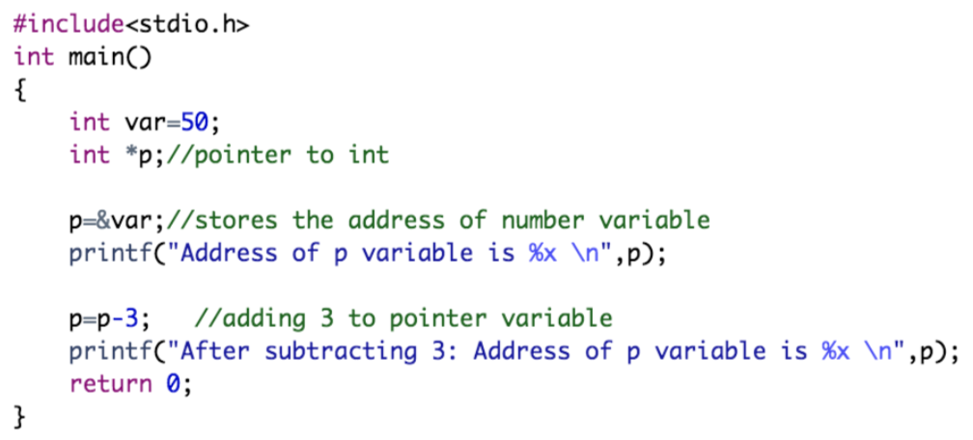
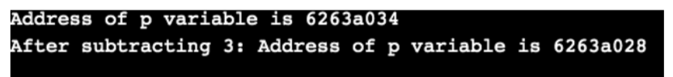
C Pointer Subtraction
Subtracting any number from a pointer will give an address
For 32-bit int variable, it will subtract 2 * multiplied by the number, as integer value occupies 2-byte memory in 32-bit OS
For 64-bit int variable, it will subtract 4 multiplied by the number, as integer value occupies 4-byte memory in 64-bit OS
Here, the address of p is 6263a034. But after subtracting 3 from p variable, it is 6263a028, i.e., 2*3=6 decrement. This is when using 32-bit architecture; it decrements 6, as integer value occupies 2-byte memory in 32-bit OS

Slide 24
C Pointer Subtraction
Subtracting any number from a pointer will give an address
For 32-bit int variable, it will subtract 2 * multiplied by the number, as integer value occupies 2-byte memory in 32-bit OS
For 64-bit int variable, it will subtract 4 multiplied by the number, as integer value occupies 4-byte memory in 64-bit OS
But if we were using 64- bit architecture, it would be decrementing by 12, i.e., 4*3=12, as integer value occupies 4-byte memory in 64-bit OS

Slide 25
Illegal Arithmetic with Pointers
Pointer stores address hence we must ignore the operations which may lead to an illegal address
In the following, a list of illegal operations is given:
Address + Address = illegal
Address * Address = illegal
Address % Address = illegal
Address / Address = illegal
Address & Address = illegal
Address ^ Address = illegal
Address | Address = illegal
~Address = illegal

Slide 26
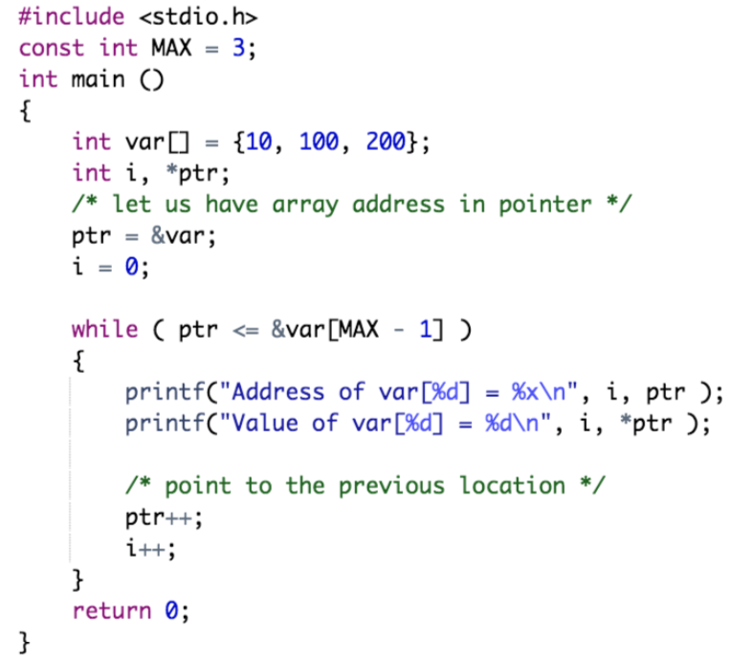
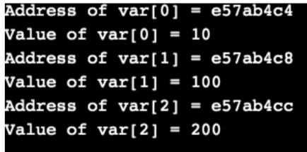
Pointer Comparisons
Pointers may be compared by using relational operators, such as ==, <, and >

Slide 27
Practical Exercises
Write and Compile the following C programs:
Program 1:

Slide 28
Practical Exercises
Write and Compile the following C programs:
Program 2:

Slide 29
Practical Exercises
Write and Compile the following C programs:
Program 3:

Slide 30
Practical Exercises
Write and Compile the following C programs:
Program 4:

Slide 31
Practical Exercises
Write and Compile the following C programs:
Program 5:

Slide 32
Practical Exercises
Write and Compile the following C programs:
Program 6:

Slide 33
Practical Exercises
Write and Compile the following C programs:
Program 7:

